Slide 1

Beers and Breweries in the State
DS: Samuel VonPaays Soh
01/2020

Slide 2
Breweries in the US
Total number of breweries in the US = 558
The highest # breweries: Colorado.

Slide 3
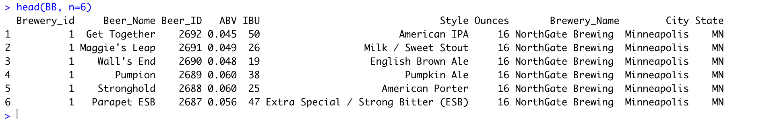
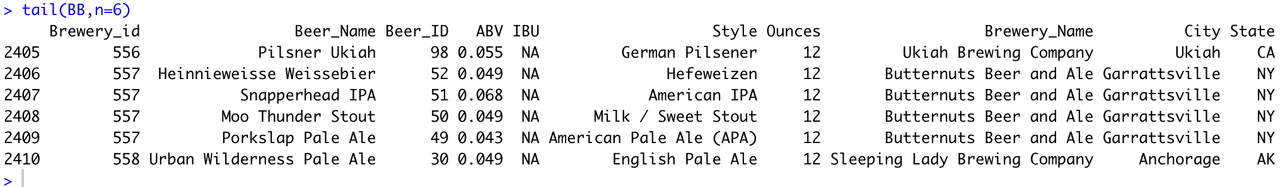
Merge Beer and Breweries

Slide 4
Median Alcohol Content and Bitterness by State
State of WV has the highest median ABV
State of ME has the highest median IBU

Slide 5
Max ABV & IBU by State
State of CO has the highest max ABV
State of Colorado has the max ABV.
State of Oregon has the max IBU.

Slide 6
7. Relationship between ABV and IBU
IBU and ABV has a correlation, 0.671.
Most of ABV is around 0.05.
Majority of IBU = ~23

Slide 7
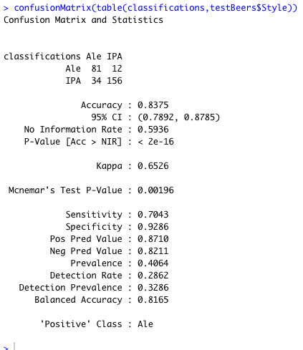
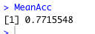
KNN on IBU and ABV
KNN
Naïve Bayes
Using Naïve Bayes modelling, the mean accuracy is about 0.78 with 100 iterations which is slightly lower compare
to KNN.

Slide 8
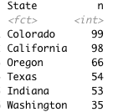
Number IPA and Ale Breweries in the State

Slide 9
YouTube link:
https://youtu.be/fFxzDc4rmG0

